Slide 1
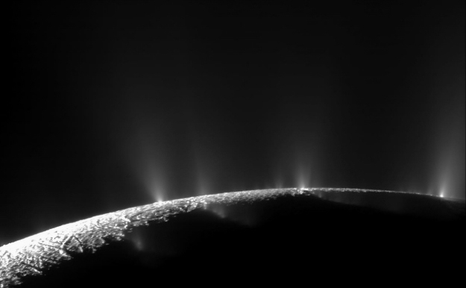



Impact-induced Spallation on Icy Moons and its Potential Effects on Habitability
1
Linae Larson
The University of Arizona
Mentor: Christopher W. Hamilton Lunar and Planetary Laboratory
2025 Arizona NASA Space Grant Statewide Symposium

Slide 2
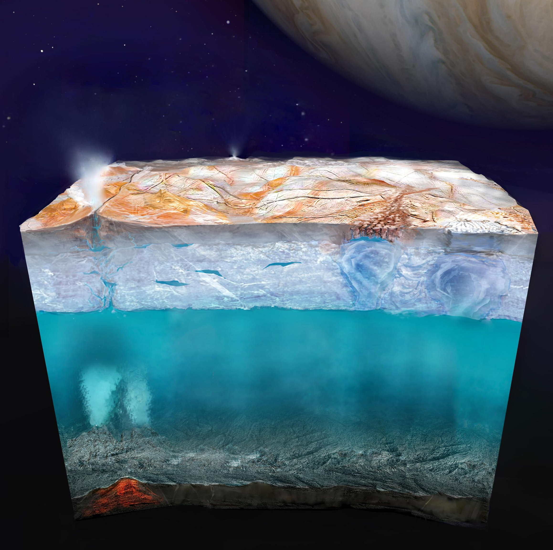
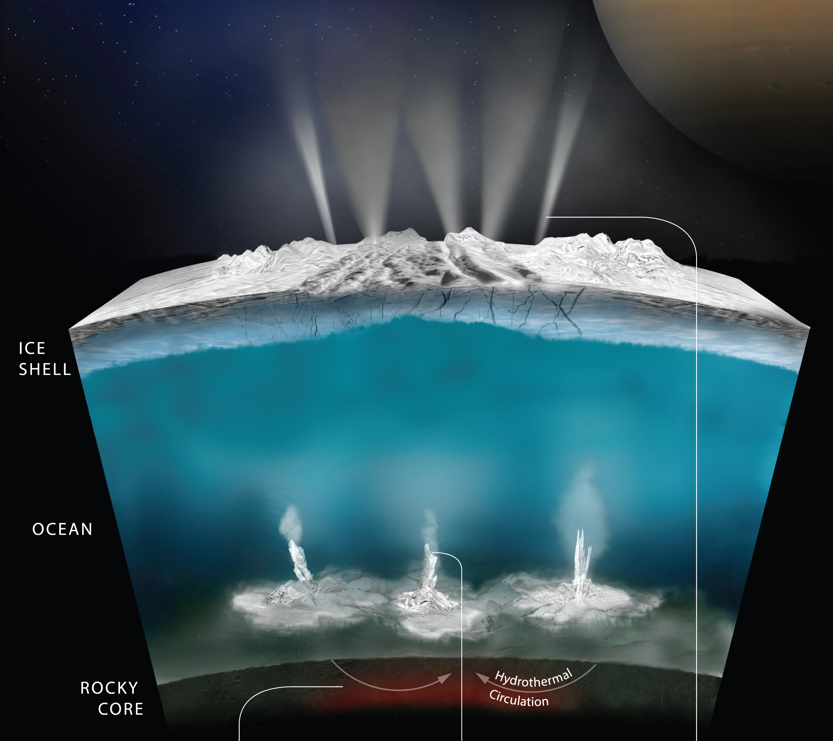
Structure of Icy Moons: Ice Shell Thicknesses
2
Europa (~5–30 km)
Enceladus (~5–20 km)
Credits: NASA/JPL-Caltech
Credits: NASA/JPL-Caltech/Southwest Research Institute

Slide 3
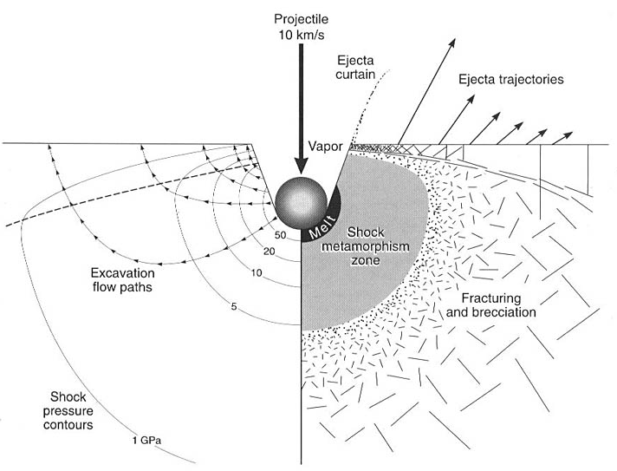
What is Impact-induced Spallation?
3
Asteroid or comet impact
↓
High-pressure shock waves
↓
Expansion waves
↓
Hit boundary
↓
Spallation
Figure from Martellato et al. (2012)

Slide 4
What is Impact-induced Spallation?
4
Asteroid or comet impact
↓
High-pressure shock waves
↓
Expansion waves
↓
Hit boundary
↓
Spallation
Existing literature only considers spallation
at the surface of icy moons
Figure from Martellato et al. (2012)

Slide 5
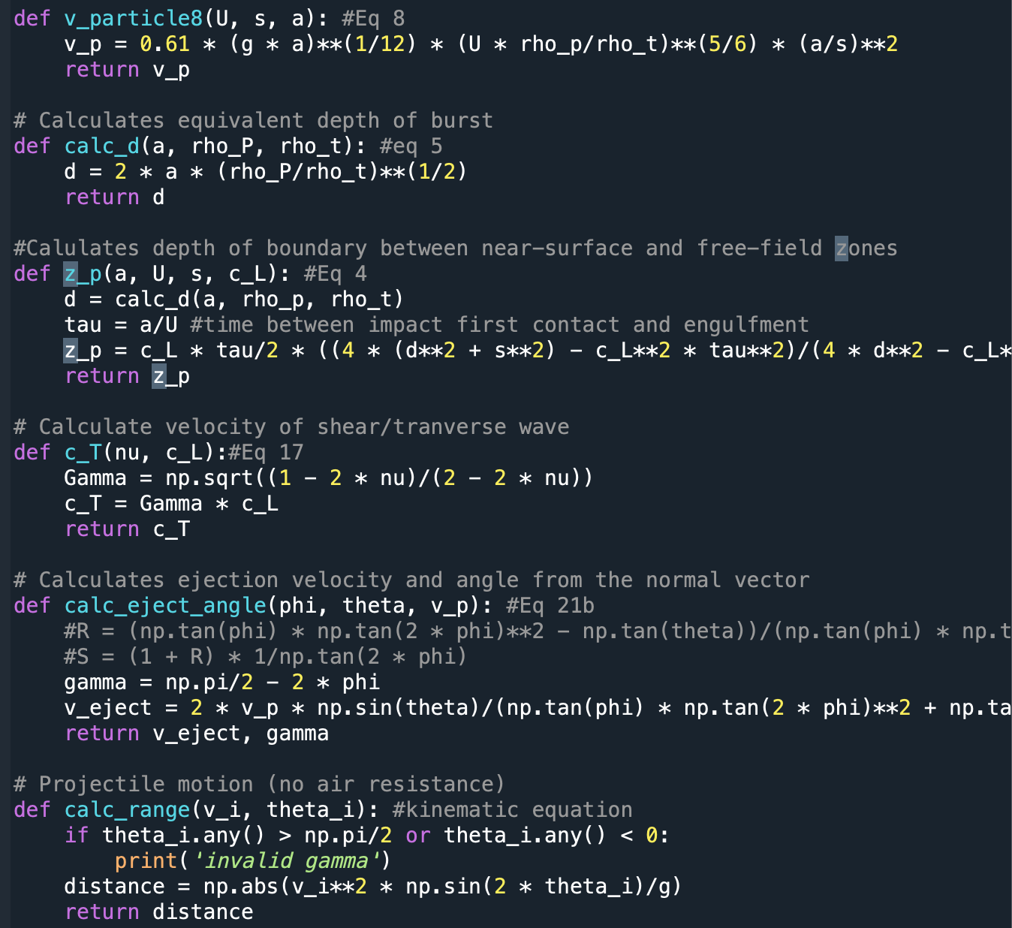
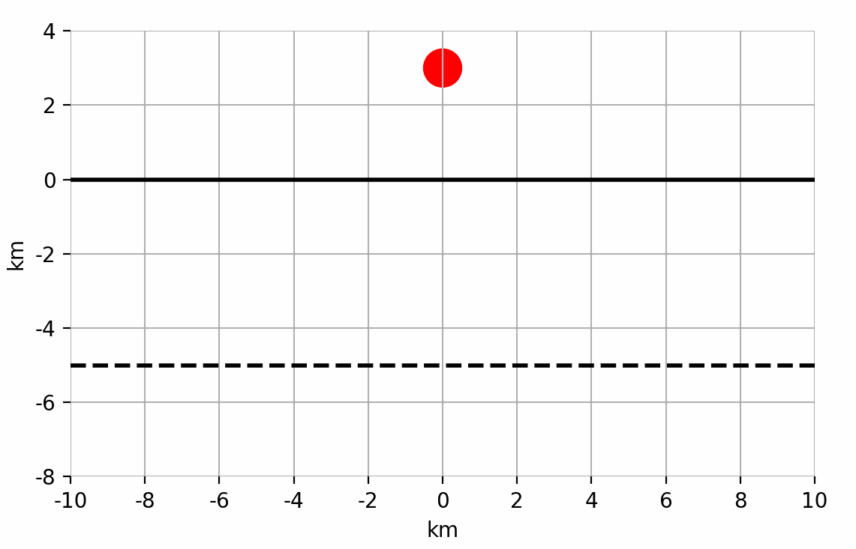
500 lines of Python later…
5
Surface
boundary
Ice-ocean
boundary
Goal: Calculate the energy input into ocean for a range of impactor sizes and velocities

Slide 6
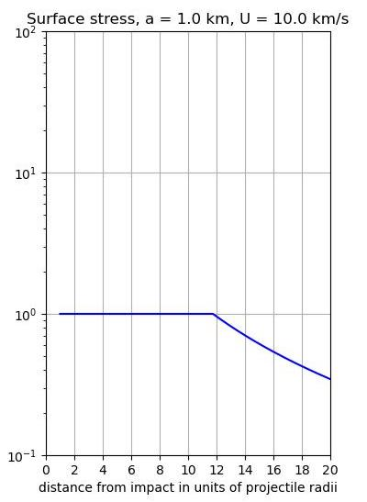
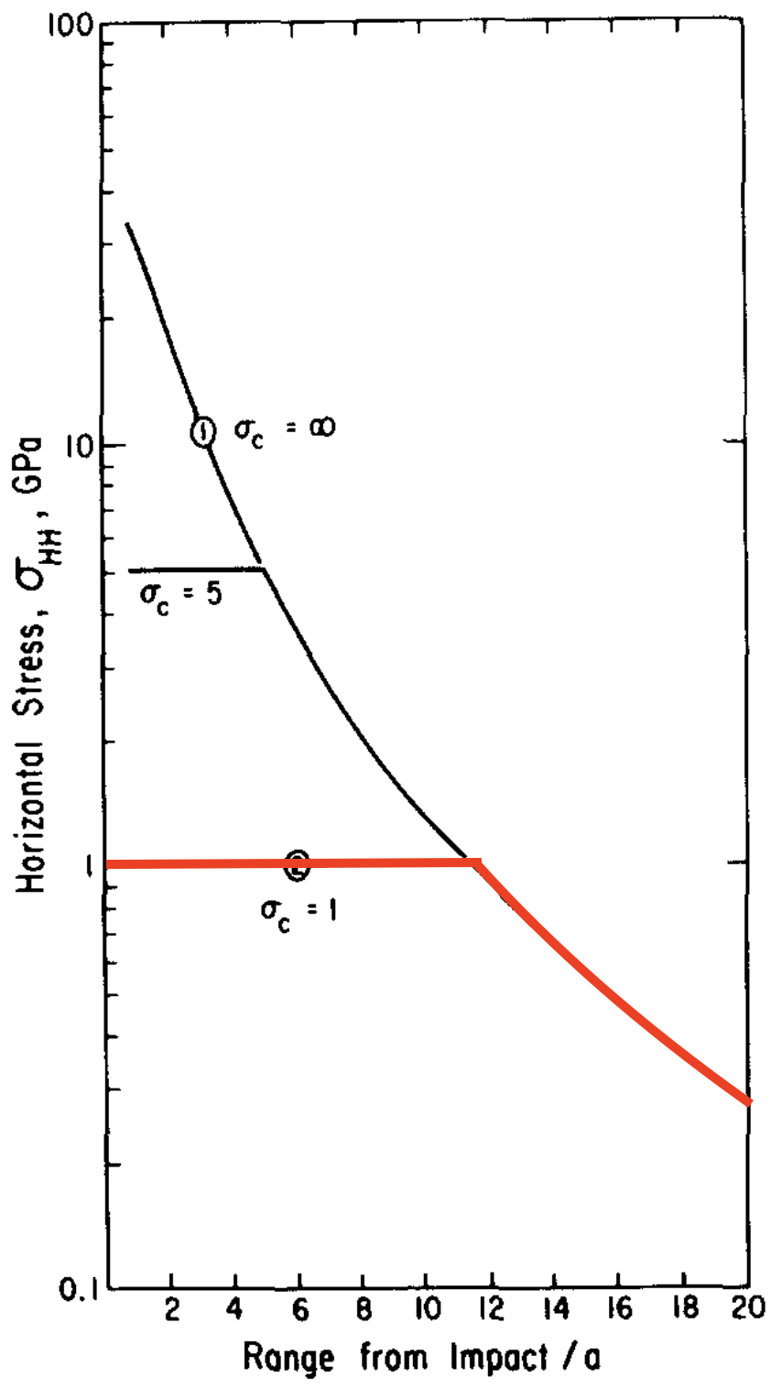
My Python Model Agrees with Melosh (1984)
6

Slide 7
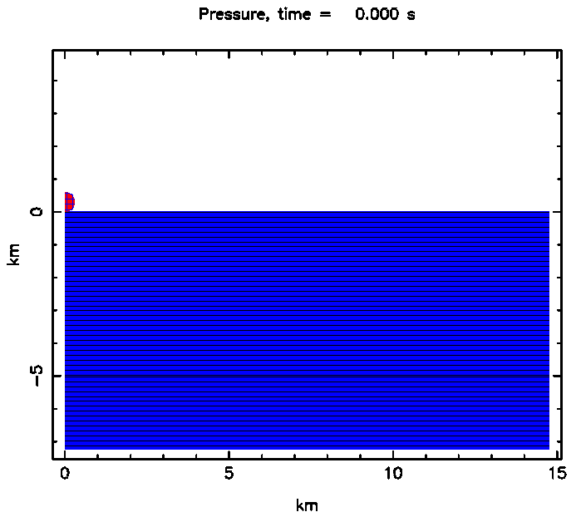
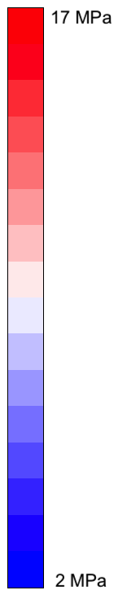
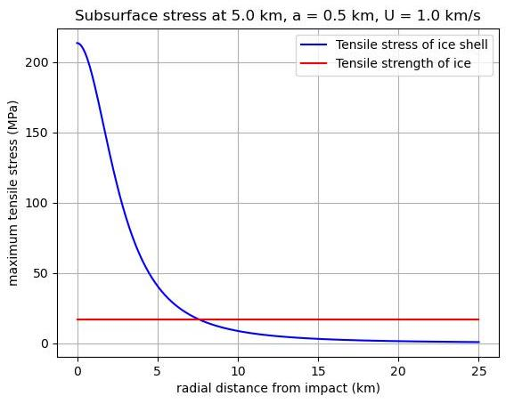
Preliminary Results
7
iSALE
Python
Ice
shell
Ocean

Slide 8
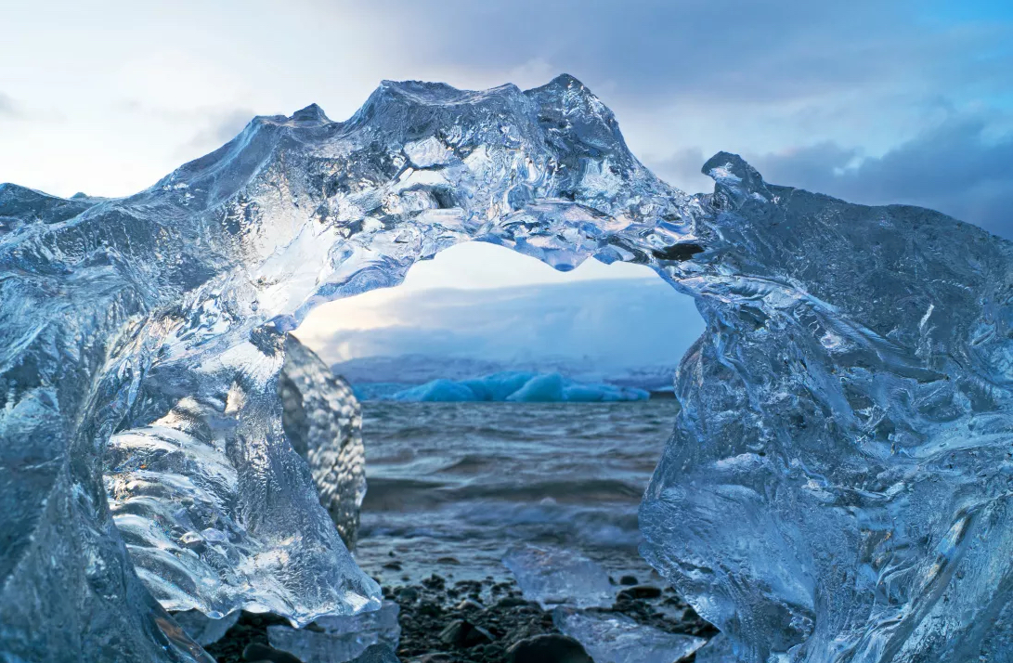
Potential Effects on Habitability
8
Case 1: Ocean Mixing
Low porosity
Expansion waves travel to ice-ocean boundary
Retains high energy
Energy input into ocean?
Credits: Nick Turner/Flickr

Slide 9
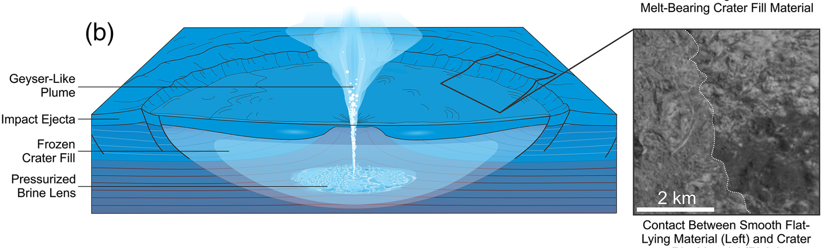
Potential Effects on Habitability
9
Case 1: Ocean Mixing
Case 2: Cyrovolcanism
Low porosity
Expansion waves travel to ice-ocean boundary
Retains high energy
Energy input into ocean?
High porosity
Energy closes cracks & pores
Generates frictional heating within brittle ice shell
Mechanism to create cryovolcanism chamber?
Credits: Nick Turner/Flickr

Slide 10
Conclusions
10
Icy moons have ice shells and subsurface oceans
Asteroid impacts can cause high-pressure shockwaves and fragments to be ejected
Applying impact-induced spallation to the ice-ocean boundary:
  May provide energy input into the subsurface ocean
  Potential mechanism for forming subsurface cyrovolcanism chamber

Slide 11
Thank You!
11
Joanna Hardesty, Wes Tucker, Veronica Bray
NASA Solar System Workings Program
Michelle Coe, Arizona Space Grant
Email: LLars@arizona.edu
Credits: NASA/JPL-Caltech/Space Science Institute

